Slide 1

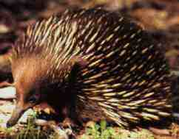
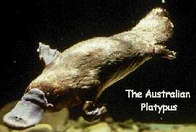
Living Monotremes
Echidna
By Cristina Hartnett
April 20, 2002

Slide 2
Taxonomy
Monotremes belong to the order Monotremata, which is in the class Mammalia, and the subclass Prototheria.
There are only two surviving families in this order.
The first family is Ornithorhynchidae, with only one living species, Ornithorynchus anatinus, the duck-billed platypus.
The second family, Tachyglossidae, consists of two living species, Tachyglossus aculeate, the short-nosed echidnas, and Zaglossus bruijnii, the long-nosed echidnas.

Slide 3
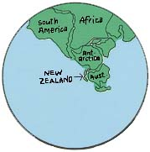
History
Monotremes split from the Mammalian lineage in the Mesozoic.
The oldest fossil of this order was found in Lightening Ridge opal fields of New South Wales, Australia. It resembles a juvenile platypus and represents the first known Australian mammal. It dates to the Cretacious period, around 100 million years old.
Giant echidna fossils were also found in Western and South Australia, which date back to the Miocene and Pleistocene.
A Paleocene platypus tooth was found in Argentina, suggesting that these animals were once distributed across southern Gondwana.
Cenozoic Era
(65 mya-present)
Quaternary Period
(1.8 mya)
Tertiary
(65-1.8 mya)
Mesozoic
(248-65 mya)
Cretacious (146-65 mya)
Phanerozoic Eon
Jurassic (208-146 mya)
Triassic (248-208 mya)
Paleozoic
(540-248 mya)
Permian (280-248 mya)
Carboniferous (360-280 mya)
Devonian (408-360 mya)
Silurian (438-408 mya)
Ordovician (505-438 mya)
Cambrian (540-500 mya)
Gondwana: 140 million years ago

Slide 4
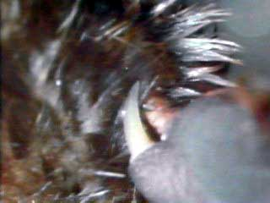
Origin
Poisonous horny spur of platypus
Monotremes, considered to be primitive mammals, share characteristics with both reptiles and mammals.
The similarities to reptiles include: laying eggs that are hatched outside the body, the presence of a cloaca, or only one opening for excretory and genital products, and resemblances in anatomical details, such as similar pectoral and shoulder girdles, limbs which are lateral to their bodies, and similar eye structures.
The similarities to mammals include: the production of milk to nourish their young, long periods of parental care, high metabolic rates (although their average body temperatures, 30-32 °C, are lower than that of other mammals), a four-chambered heart, a body covered with hair, a single dentary bone, and three inner ear bones.
They also show similarities to birds, having a long rostrum and incubating their eggs.
In addition, monotremes have unique qualities. They have no teeth as adults, they have a penis attached in the interior of their cloaca, and have horny spurs on the back of their ankles, which, in platypus, are poisonous.

Slide 5
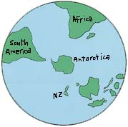
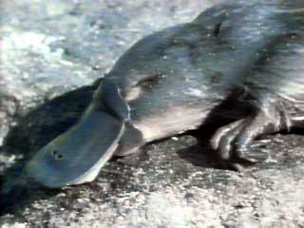
Ecology of Platypus
Platypus and its sensitive bill
Eastern Australia
Platypus live in freshwater systems of Eastern Australia.
They are excellent diggers and use these skills to create burrows to hibernate in and to hunt for food.
They are crepuscular, aquatic, bottom-feeders, which have keratinized pads instead of teeth for chewing and crushing their food.
They use their sensitive bills to hunt underwater for insects and their larvae, bivalves, gastropods, and freshwater crustaceans.
Although they hunt for food underwater, they store the food they catch in their cheek pouches until they reach the surface.

Slide 6
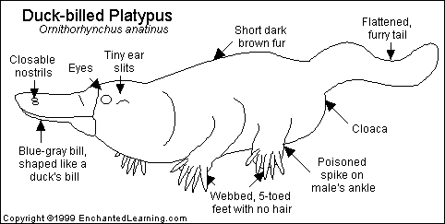
Morphology of Platypus
Platypus weigh 0.5-2.0 kilograms as adults.
They have flat tails, webbed feet with five digits, and dense wooly water-repellant fur.
Sphincter muscles close off their nares when they are diving. Their ears, as well as their eyes, are further protected by the furrows along the sides of their heads.
Their soft, leathery bill is sensitive to tactile stimulation and weak electrical fields, which helps them to sense prey when digging underwater.
They have the brain structure of a mammal, but their braincases are small.

Slide 7
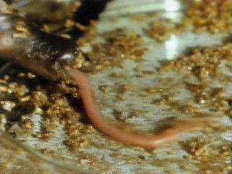
Ecology of Echidnas
Tasmania
Eastern Australia
New Guinea
Tongue of an echida
The long-nosed echidnas are found only in New Guinea, and feed on earthworms and scarab beetles.
The short-nosed echidnas are found in New Guinea, Eastern Australia, and Tasmania, and they feed on mostly ants and termites.
They are powerful diggers, live in burrows, and dig for their food.
Their slender, long (up to 18 cm) tongues are covered in mucous, allowing them to lap up their food. The roof of their mouths are covered in spines for grinding their food.
They have poor eyesight, but a great sense of smell. Electroreceptors in their rostri help to locate prey.
They are crepuscular and solitary, and curl up into a ball for defense against predators.
They hibernate in the winter, where their body temperatures reach as low as 5 °C and their pulses drop to as low as 7 beats per minute.

Slide 8
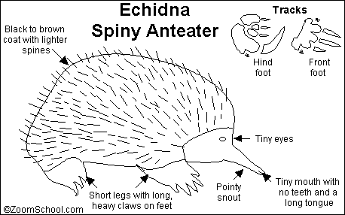
Morphology of Echidnas
Echidnas have spines covering their round, fat bodies, which can be erected by skin musculature.
They do not have webbed feet, as in platypus, but they have large shovel-like claws.
They have similar brain structures as platypus, but larger braincases.
Their skeletons are heavily built, possibly to accommodate for their powerful digging muscles.

Slide 9
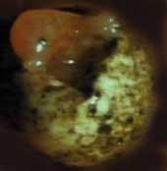
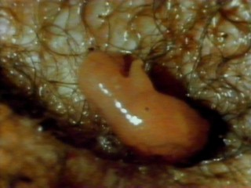
Reproduction of
Platypus and Echidnas
Monotremes lay 1-3 small, (13-15 mm) leathery eggs per year. They have yolk distribution similar to that of birds, with a large yolk concentrated on one end. The offspring have a milk tooth, which helps them to break out of their shell. In addition, the milk that the mother produces from her mammary glands is secreted on her skin and sucked or lapped up by the young.
Platypus are a sexually dimorphic species, due to competition for mates, with the male being the larger one. Males and females often burrow together, or very near each other. Once the female is about to lay her eggs, she retires to a burrow in the bank of a river or a pond, which is lined with vegetation. She plugs the entrance and incubates the eggs for 10-12 days. Hair develops in the young at 7 weeks, their eyes open at 9 weeks, and they suckle for 16 weeks. In platypus, only the left ovary is functional.
Echidnas have two functional ovaries. Females keep their eggs in a pouch on their stomachs for 7-10 days. Once they hatch, they remain in the pouch for another 6-8 weeks until their spines harden. They are weened at 20 weeks.
The emergence of a monotreme, using its milk tooth to break out of the shell
An echidna lapping milk

Slide 10
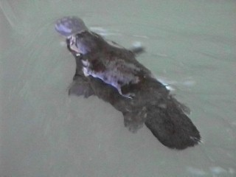
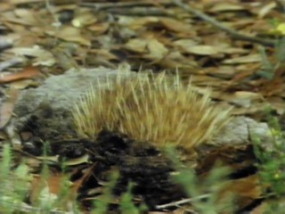
Images and
Literature Cited
Echidna burrowing
Platypus swimming
Atkins, D. “Mammalian Subclass Prototheria.” 1999. Online. George Washington University. Internet. 14 April, 2002. Available: http://gwis2.circ.gwu.edu/atkins/newwebpages/Mammalia/monotremata/monotremata.html.
Blomstrom, D. “Monotremes.” 2002. Online. Geobopological Survey. Internet. 17 April, 2002. Available: http://www.geobop.com/mammals/monotremata/.
“Echidna.” Available: http://aquarium.virtualave.net/echidna.html.
Enchanted Learning Software. “Geologic Time Scale.” 2002. Online. Internet. 24 April, 2002. Available: http://www.enchantedlearning.com.
Kiwi Coservation Club. “Unique New Zealand.” 2001. Online. Royal Forest and Bird Protection Society of New Zealand, Inc. Internet. 17 April, 2002. Available: http://www.kcc.org.nz/places/uniquenz.htm.
Pearl-Hodgins, C. “Australia Animal Research Webquest.” 2002. Online. Ecole Whitehorse Elementary. Internet. 17 April, 2002Available: http://www.yesnet.yk.ca/schools/wes/webquest/australian_animals/animals_list.html.
“Platypus.” Available: http://aquarium.virtualave.net/platypus.html.
Sorin, A. and Myers, P. “Ornithorhynchidae.” 1999. Online. University of Michigan Museum of Zoology. Internet. 14 April, 2002. Available: http://animaldiversity.ummz.umich.edu/chordata/mammalia/monotremata/ornithorhynchidae.html.
Sorin, A. and Myers, P. “Tachyglosidae.” 1999. Online. University of Michigan Museum of Zoology. Internet. 14 April, 2002. Available: http://animaldiversity.ummz.umich.edu/chordata/mammalia/monotremata/tachyglossiidae.html.
Sorin, A. and Myers, P. “Order Monotremata.” 1999. Online. University of Michigan Museum of Zoology. Internet. 14 April, 2002. Available: http://animaldiversity.ummz.umich.edu/chordata/mammalia/monotremata.html.
Speer, B.R. “Monotremes.” 2002. Online. University of California Museum of Paleontology. Internet. 14 April, 2002. Available: http://www.ucmp.berkeley.edu/mammal/monotreme.html.
Speer, B.R. “Monotremata: Systematics.” 2002. Online. University of California Museum of Paleontology. Internet. 14 April, 2002. Available: http://www.ucmp.berkeley.edu/mammal/monotremesy.html.
Speer, B.R. “Monotremata: Life History and Ecology.” 2002. Online. University of California Museum of Paleontology. Internet. 14 April, 2002. Available: http://www.ucmp.berkeley.edu/mammal/monotremelh.html.
Speer, B.R. “Monotremata: Fossil Record.” 2002. Online. University of California Museum of Paleontology. Internet. 14 April, 2002. Available: http://www.ucmp.berkeley.edu/mammal/monotremefr.html.

